Slide 1
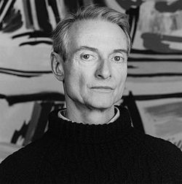
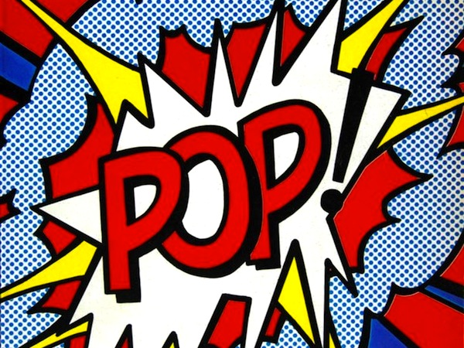
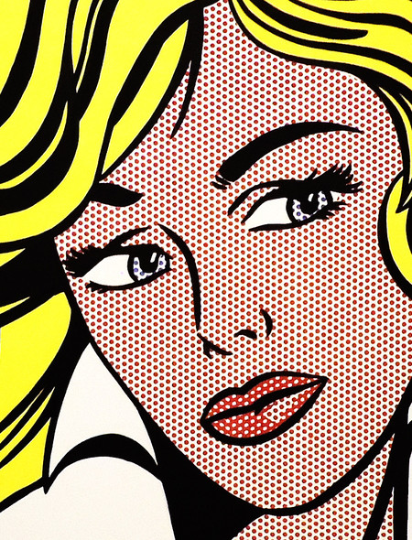
Roy Lichtenstein
3 to 5th grade
Superhero self-portrait

Slide 2
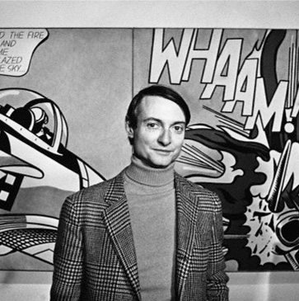
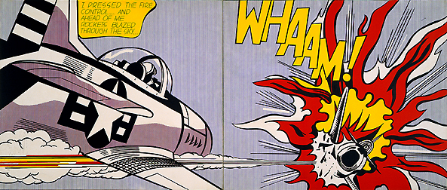
Who is Roy Lichtenstein?
Roy Lichtenstein was born in New York in 1923. He loved to draw, but art classes were not offered at his school. He kept practicing art in his free time. It was not until he went to college that he took his first art class. He kept creating art for it was what he loved doing best. Through his art work and love of what he did, his work began to become more and more popular.

Slide 3
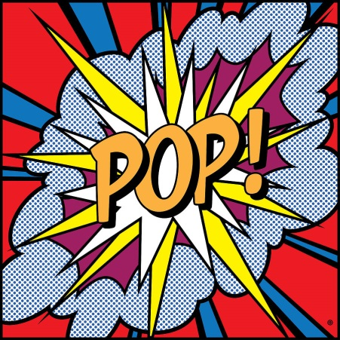
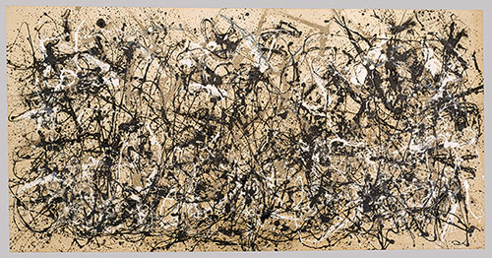
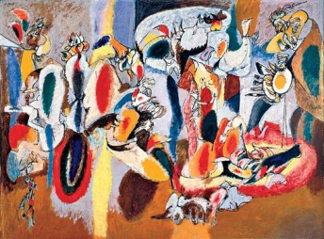
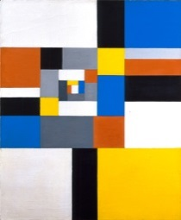
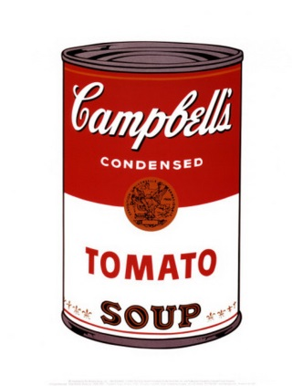
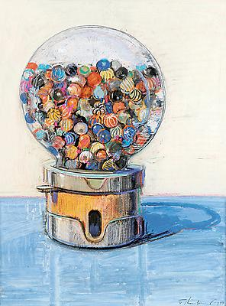
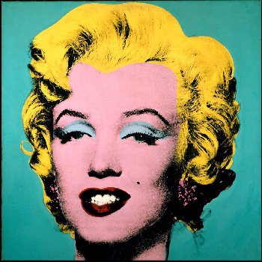
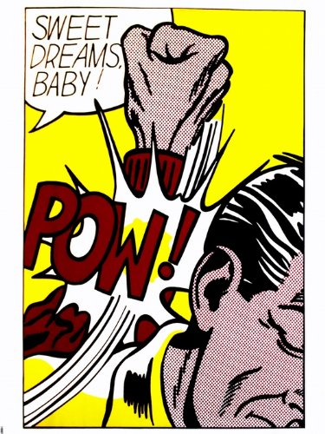
Pop Art is a British and American artistic style of 1950s-60s.
Most artists in 50s focused on emotions and feelings through abstract art
Pop Artists decided to do the exact opposite.
Pop Artists focused on the real world that people interact with every day:
Brands and logos
Common objects
Famous people
Comic books

Slide 4
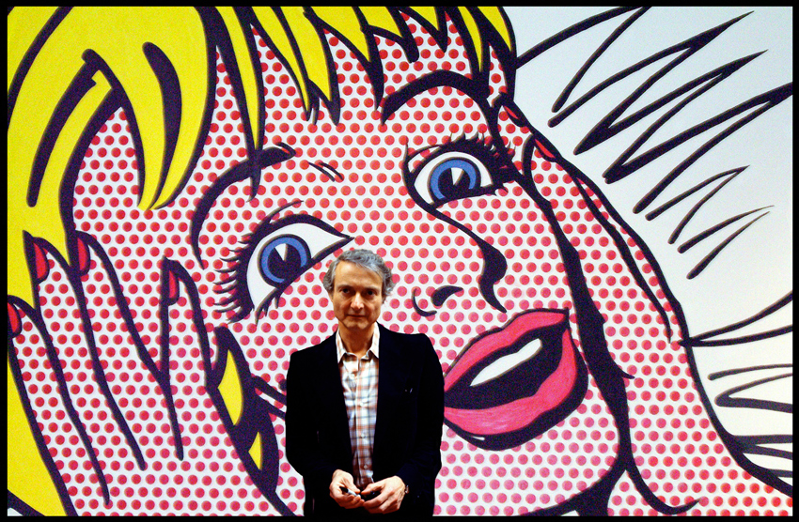
Roy was one of the founders of the Pop Art

Slide 5
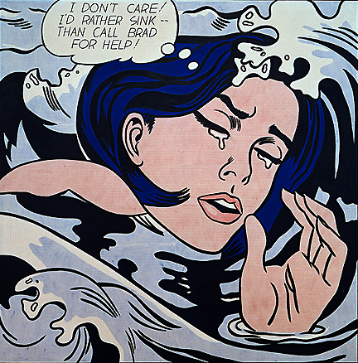
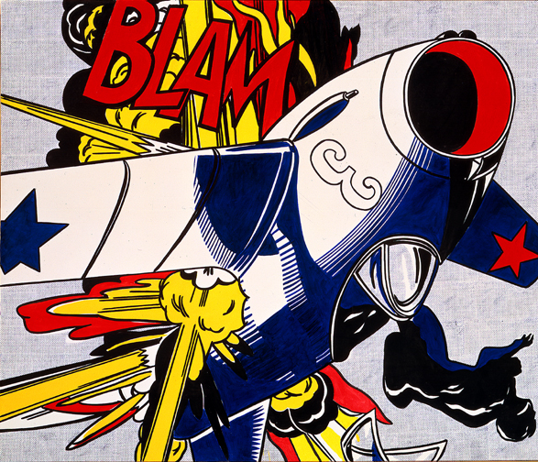
Have you noticed his art looks like comic books?

Slide 6
Roy was inspired by comic books. He created his first piece of Pop Art in 1961. It wasn't very well liked. Many critics thought he was the worst artist to ever live. Lichtenstein did not become discouraged.
One of his top paintings, entitled The Car sold for a record breaking $16.2 million dollars! Not too bad for someone who was considered the worst artist to ever live.
Lichtenstein art pieces tend to have thick bold outlines, Benday dots (a dot technique used in printing color in newspapers and comic books) and a strong use of primary color schemes (red, yellow, blue). He has also been known to place speech bubbles within his composition.

Slide 7
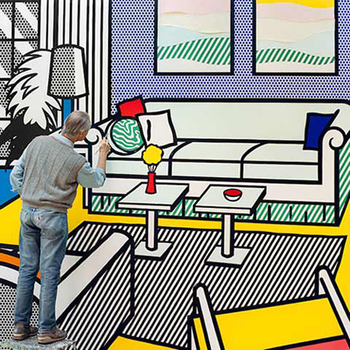
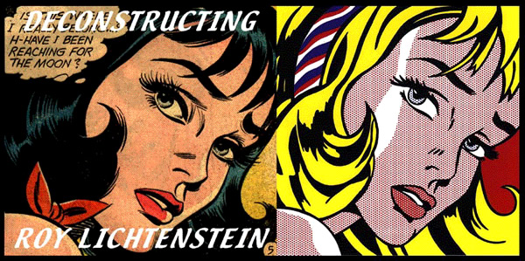
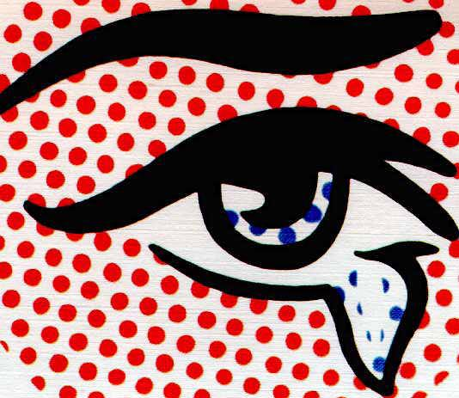
Why dots?

Slide 8
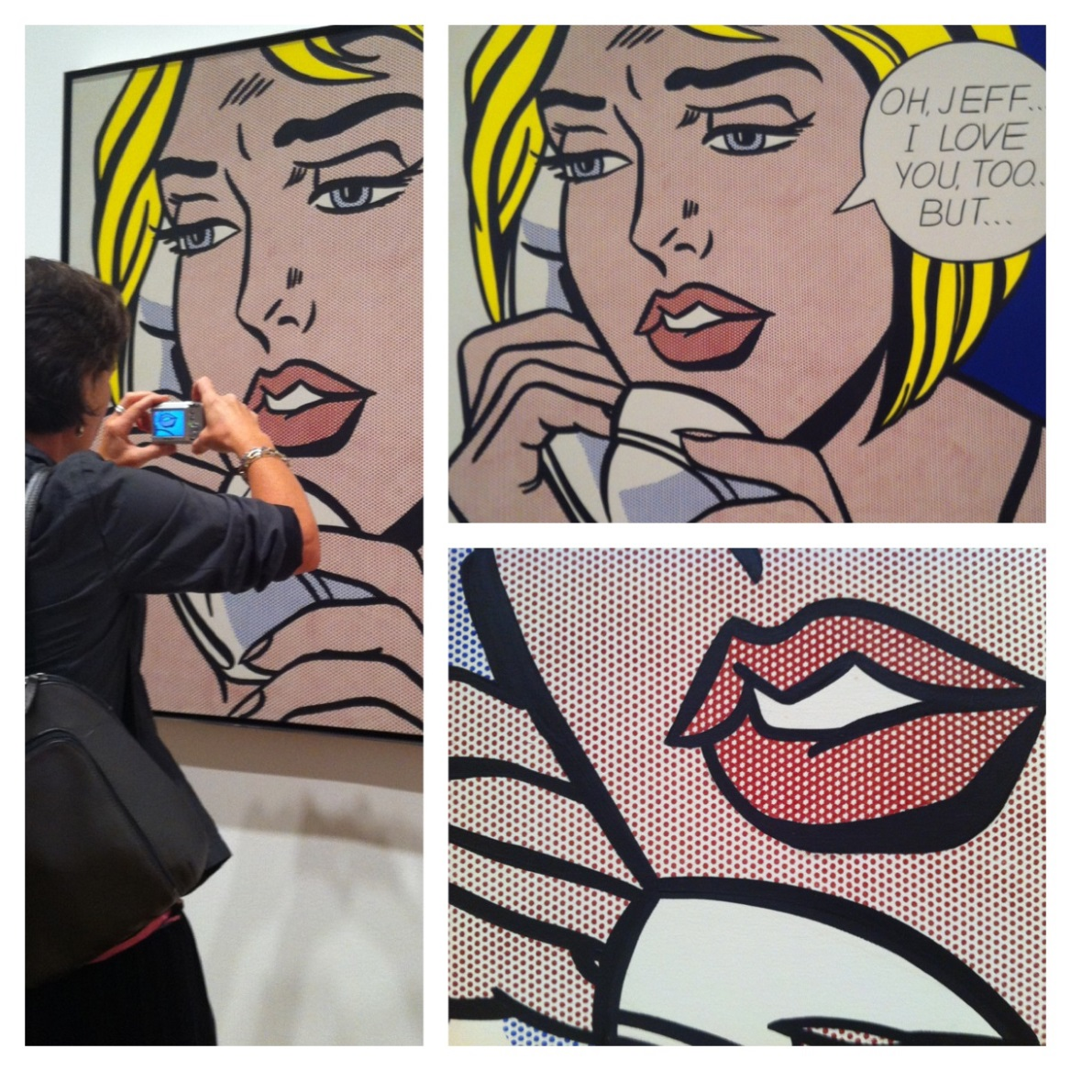
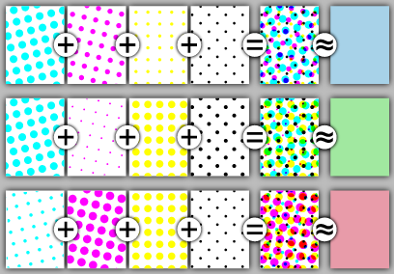
Ben Day Dots
Roy tried to capture the Ben Day Dots.
They were originally used for printing colorful pictures in a cheap way.
How?
You could make all of the colors by spacing four different colors of dots close together, far apart, or on top of each other.

Slide 9
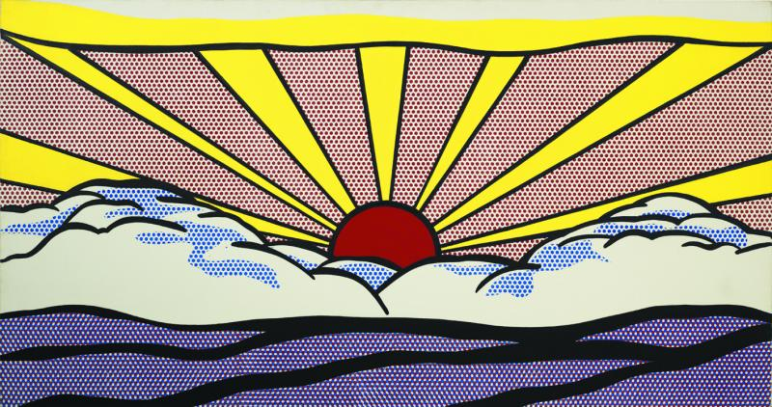
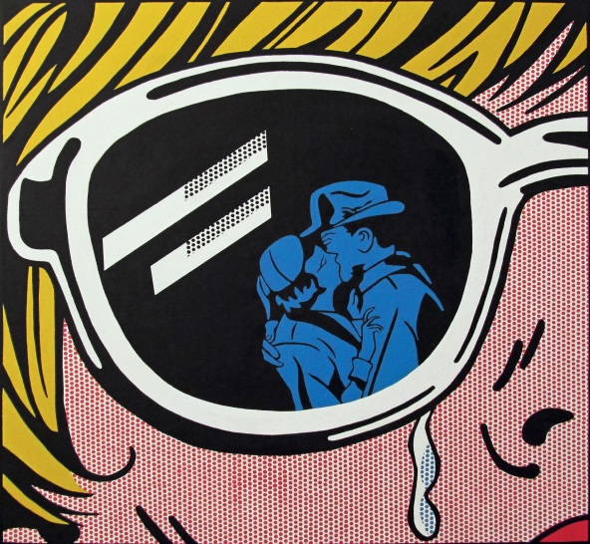
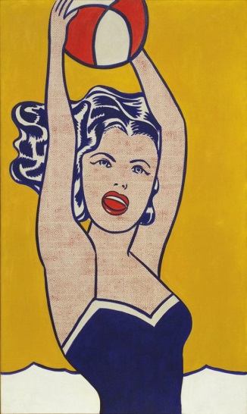
First: the primary colors
Roy used mostly primary colors in his art.
What are primary colors?
Primary colors are the most basic ones.
They cannot be made by combining other colors.
They are: yellow, red and blue.

Slide 10
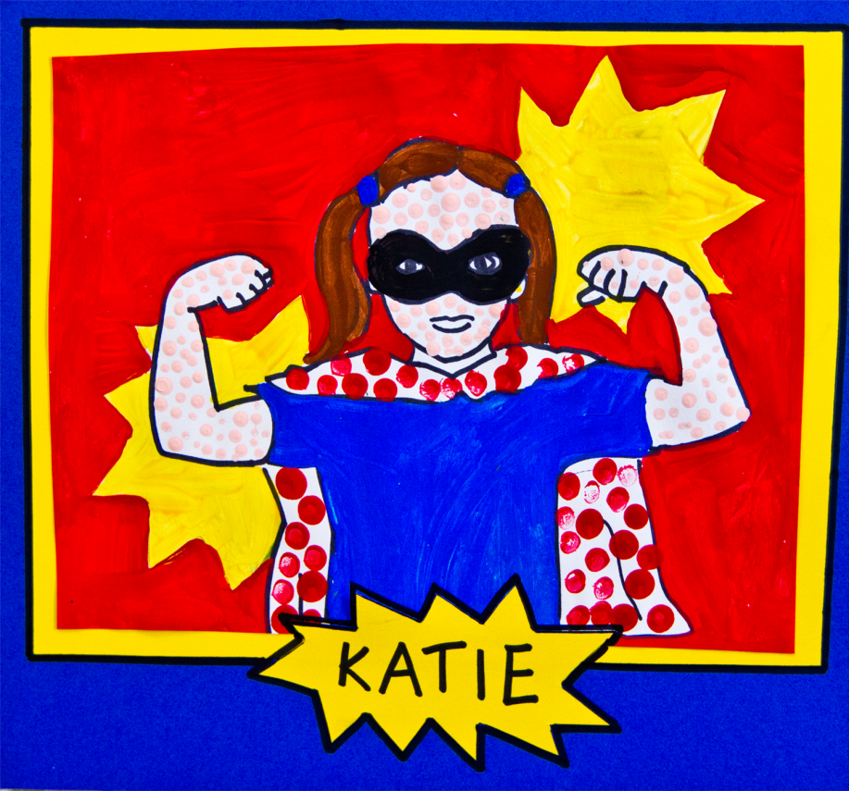
Let’s make some ART!

Slide 11
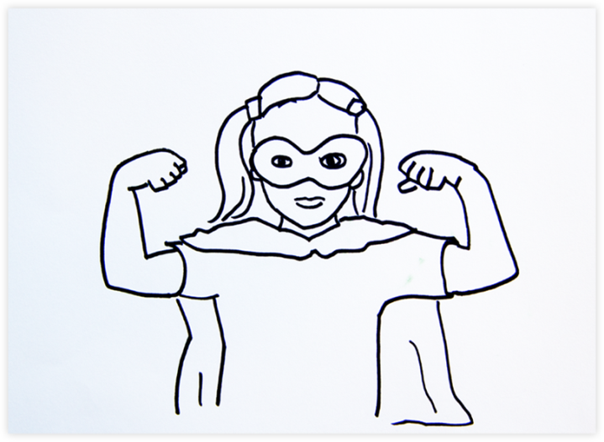
Find your superhero pose!
Choose your superhero pose and sketch it starting with your superhero head.
Trace it with a black sharpie.
Simplify! Focus on large shapes, important features and bold colors.

Slide 12
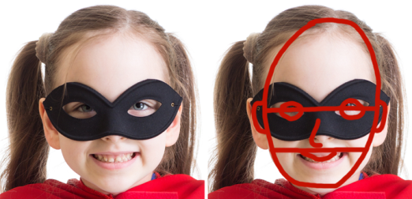
Remember, when drawing your features…
your eyes are in the middle of your face!
Add a dot in the center of your head shape.
Draw two eyes on that same plane.
Add a nose and a mouth.
Draw a neck (two small vertical lines from the head down)
Do you want to add a headband? Mask?
Add your superhero hair. Pigtails, pony tails, spikey hair…be creative!

Slide 13
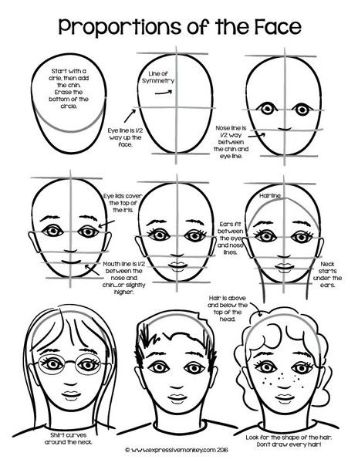

Slide 14
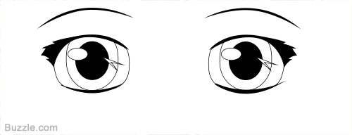
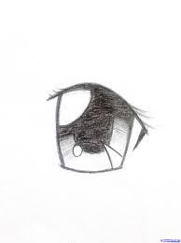

Slide 15
Next draw your body shape. Choose your super hero pose.

Slide 16
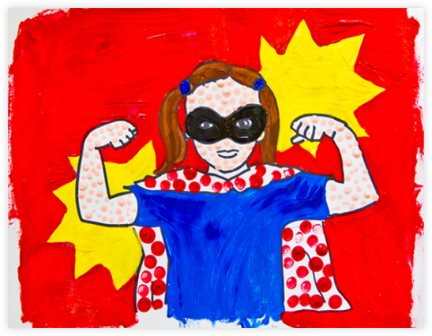
Add zigzag lines behind your superhero to add an accent and make your hero stand out. Outline everything with a black sharpie.

Slide 17
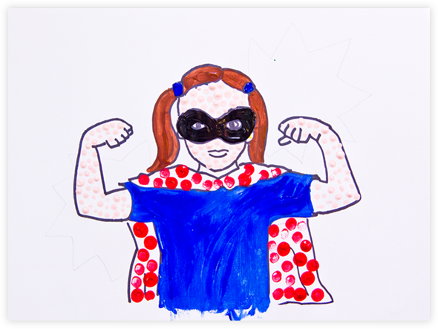
Paint it in with primary colors and dots
Add your Ben Day Dots where ever you choose using colored sharpies, or the end of your paint brush dipped in paint. It is easier to use sharpies in small spaces.
Paint the rest of your portrait using the paints provided.
Some parts will be dotted, others solid. You choose!

Slide 18
Use the white 5x6 paper to add your superhero name and superpower.
What are you good at? What do you love to do?
Use a pencil first, and your very best all capitals handwriting. Go over it with a colored sharpie.
Some examples are…
I am Super Kailey and my superpower is Baking!
This is Super Joe and his superpower is reading!
I have the power to Draw!
I have the power to Clean my room!
I have Computer Power!
Cut out your superhero on the outside of the black sharpie lines. Choose 1 large colored paper, and 2 additional contrasting papers. Cut one paper using zigzag cut around the entire sheet.
Layer the pieces as you like and glue them down.

